Slide 1
PROJECT-BASED LEARNING | REVIEW 4
TEAM
LMS: Learning Management System
Srivalli
2510030109
Rama Gayathri
Role-based portals for Students, Faculty and Admin built with React, Flask and PostgreSQL
2510030213
Chakrika
FACULTY MENTOR
[Faculty Mentor Name]
2510030285
DEPARTMENT
Computer Science & Engineering
Chandana
2510030376
ACADEMIC YEAR
2026 - 2027
Notes:
Introduce the project title, team members and mentor. Replace [Faculty Mentor Name] with your mentor's name.

Slide 2
Project Objectives
1
Centralise academic work
2
Role-based portals
One platform for attendance, assignments, quizzes, grades, materials and online classes.
Separate Student, Faculty and Admin portals, with permissions enforced on the server using JWT.
3
Automate assessment
4
Spot at-risk students early
Quizzes are auto-graded on the server and marks are converted to grades automatically.
Rule-based alerts for low attendance or marks; faculty get an at-risk list per subject.
5
Protect data and files
6
Simple administration
Files open only to members of a subject; uploads are type-checked and limited to 25 MB.
Admins manage users, departments, subjects, enrollments and timetables in one place.
LMS | PBL Review 4
2 / 11
Notes:
Walk through the six objectives. Each one is implemented in the code: JWT role checks, auto-graded quizzes, rule-based insights in services.py.

Slide 3
Project Development Approach
1
2
3
4
5
6
Requirements
Database Design
Backend API
Frontend UI
Integration & Security
Testing & Demo
Identified needs of students, faculty and admins; listed features per role.
Designed 15 related tables (users, subjects, attendance, quizzes, marks...) with SQLAlchemy.
Built Flask REST routes in five modules with JWT login and role checks.
Built 24 React pages with React Router, one portal per role.
Connected UI to API; server-side permissions, validation and file rules.
pytest tests for each role flow; seeded demo data for the demonstration.
LMS | PBL Review 4
3 / 11
Notes:
Explain the flow left to right: requirements, database, API, UI, integration, testing.

Slide 4
Project Implementation
Frontend
React 18, Vite 5, React Router 6, custom CSS
Backend
Python 3.10+, Flask 3, Flask-JWT-Extended (auth), Flask-CORS
Database
PostgreSQL (SQLite for quick start), SQLAlchemy ORM, 15 tables
APIs
REST + JSON, 60 endpoints under /api, JWT Bearer token on every protected route
Dev Environment
Python virtual env, Node 18+ / npm, pytest, seed.py for demo data, Vite dev server proxying /api to port 5000
LMS | PBL Review 4
4 / 11
Notes:
Technologies as listed in package.json, requirements.txt and README.

Slide 5
System Architecture
User
Frontend
API / Backend
ORM
Database
Student, Faculty or Admin in a browser
React + Vite. Pages per role; fetch() with JWT
Flask REST. Verifies JWT and role on every route
SQLAlchemy models map Python objects to tables
PostgreSQL / SQLite. 15 tables
Response: JSON data returns through the API to the React UI, which renders it for the user's role
Security
Files
Deployment
JWT + role check on every route; 401 without token, 403 for wrong role
Stored in backend/uploads; served only to subject members
Dev: Vite proxy. Single-server: Flask serves the built React app
LMS | PBL Review 4
5 / 11
Notes:
Request path: User -> React frontend -> Flask API (JWT + role check) -> SQLAlchemy -> database, then JSON response back to the UI.

Slide 6
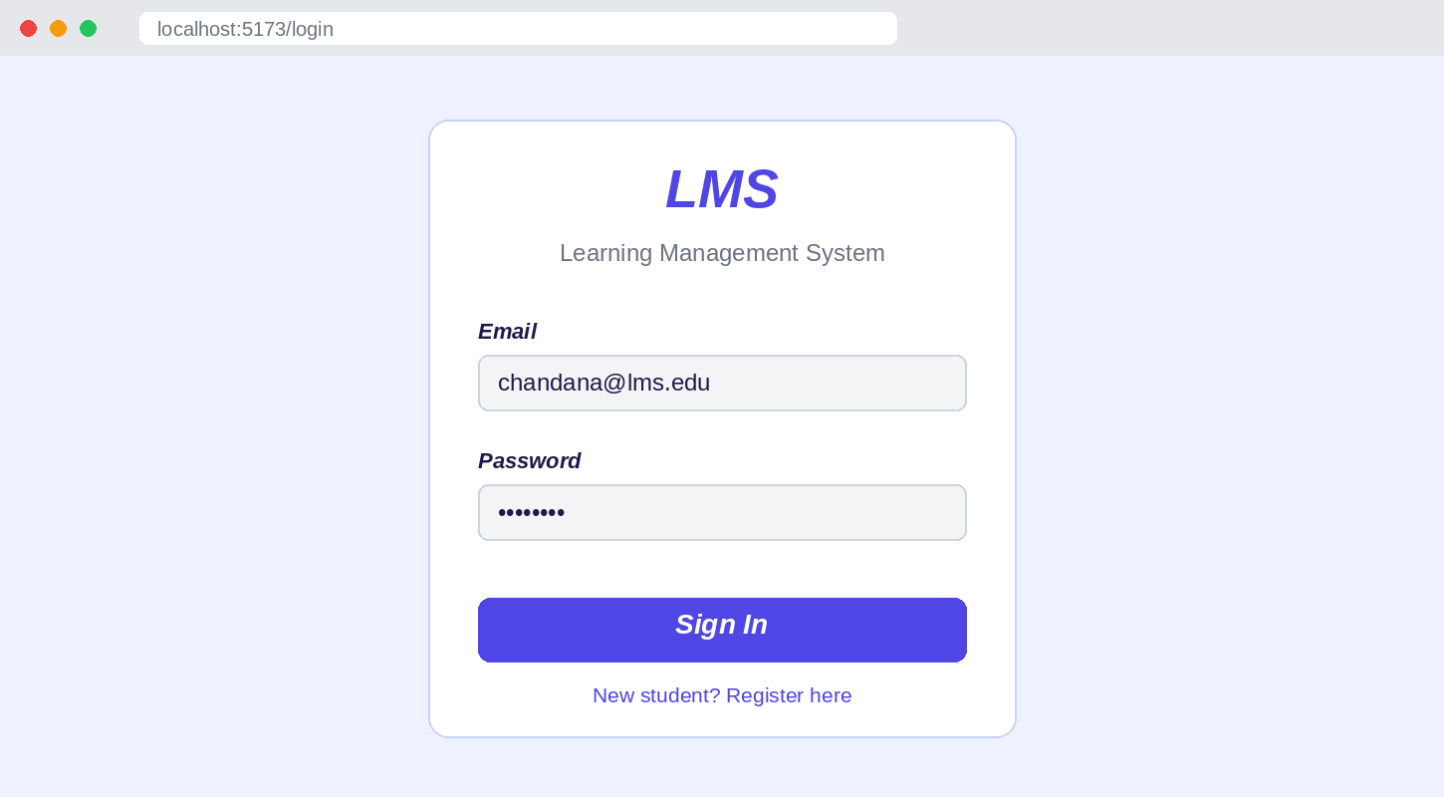
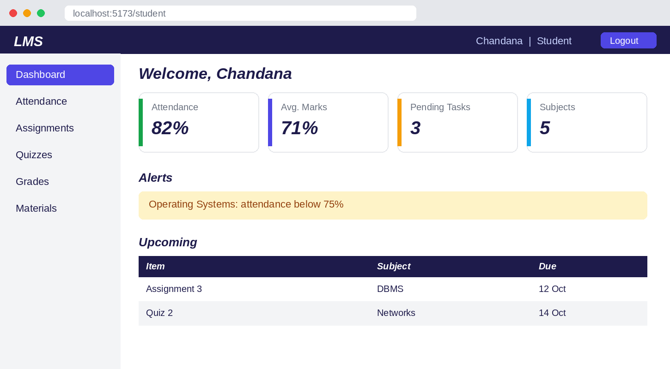
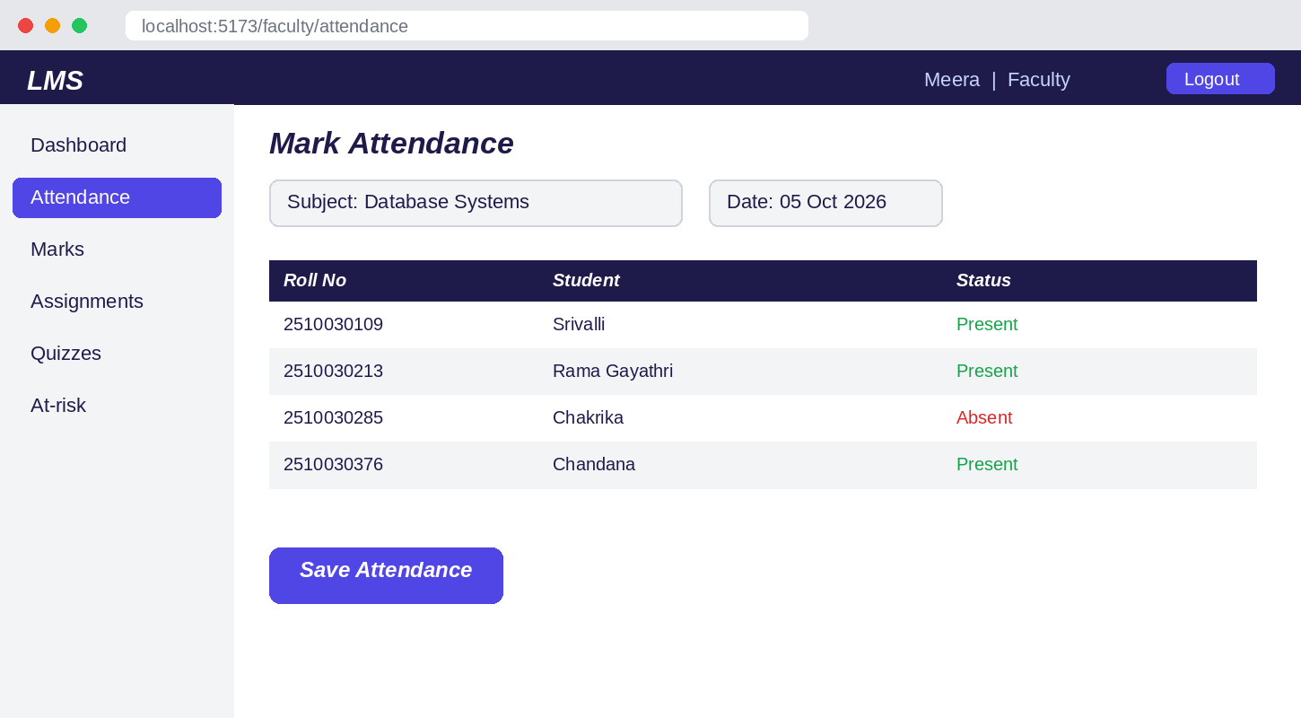
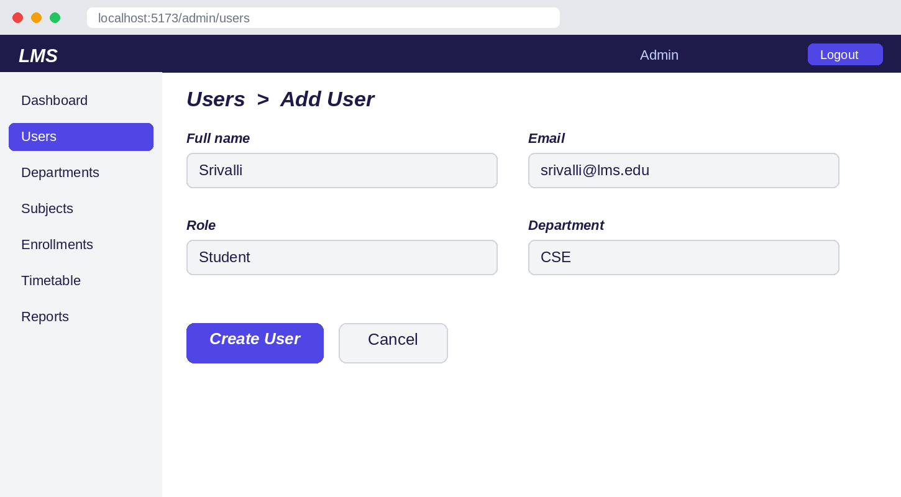
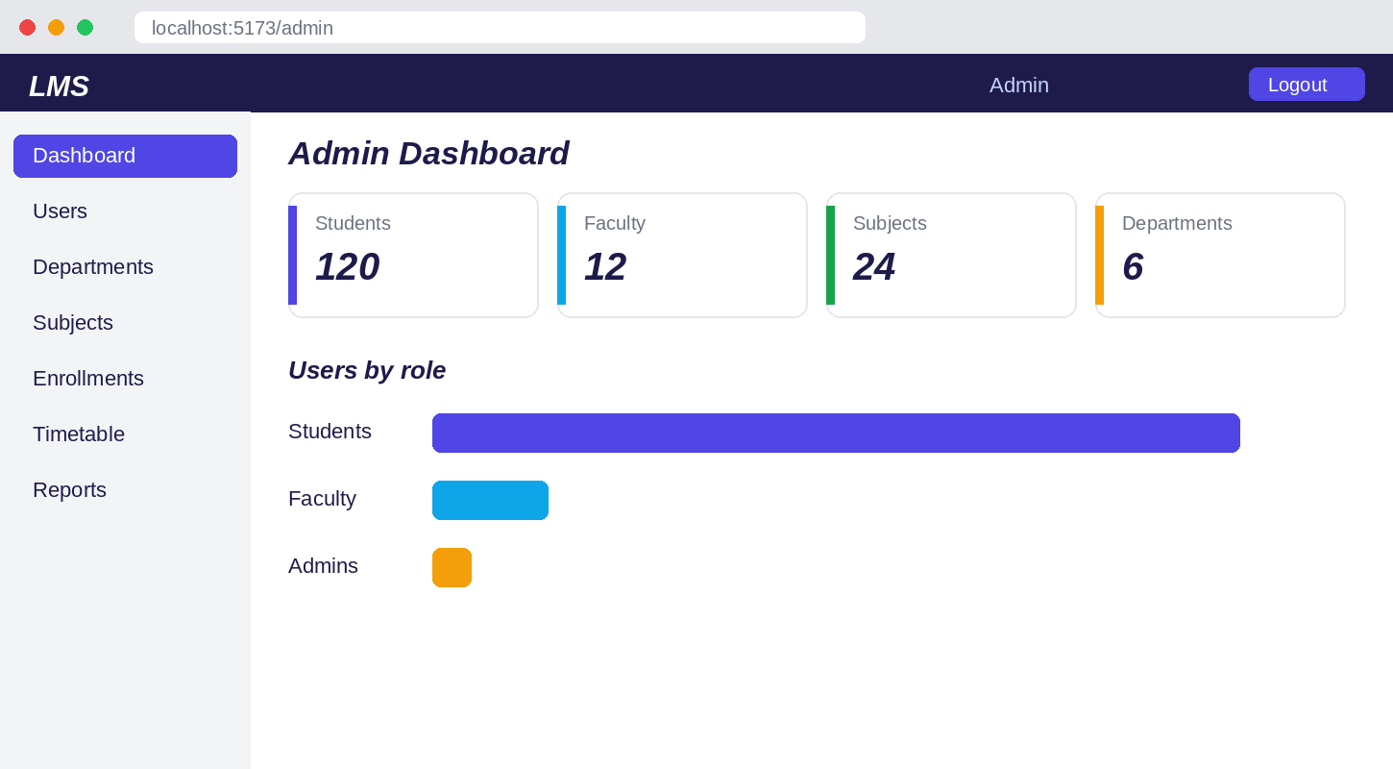
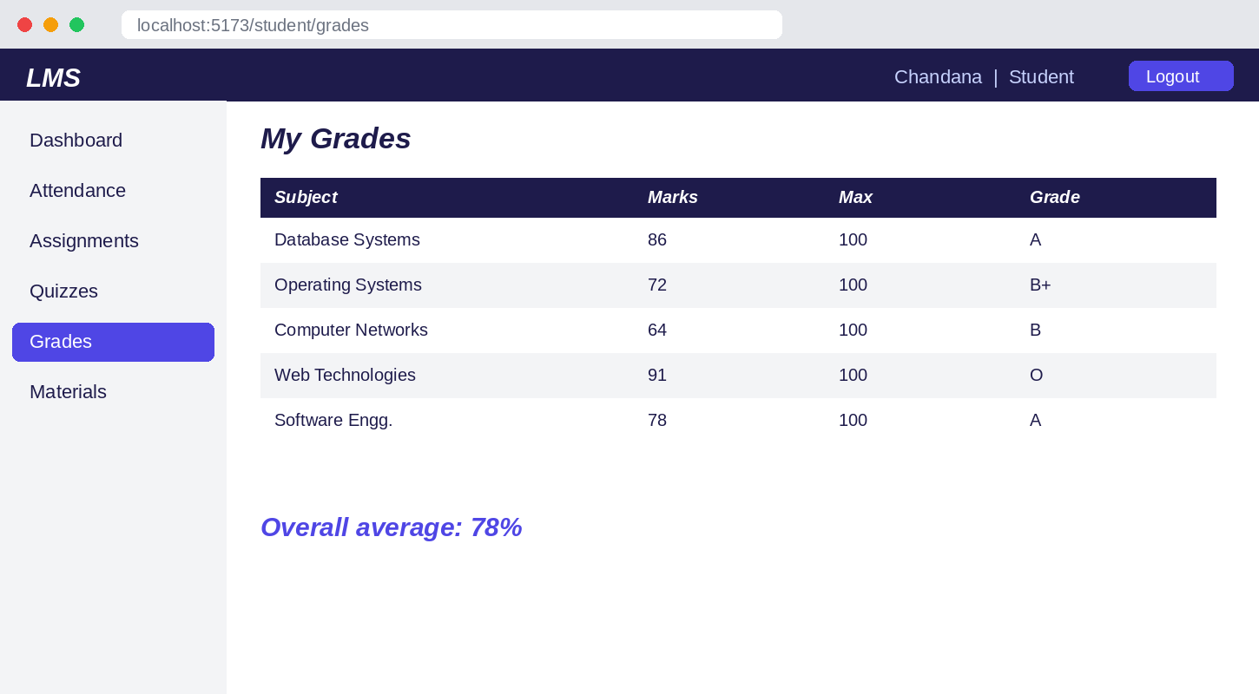
Screens / Working Demonstration
Login page
Home page
Main application
Forms
Dashboard
Output / result page
LMS | PBL Review 4
6 / 11
Notes:
Run the app (python seed.py --reset; python app.py; npm run dev). Log in with the demo accounts on the login page and take screenshots: Login; Student dashboard (chandana@lms.edu); Faculty attendance (meera@lms.edu); Admin > Users form; Admin dashboard; Student Grades or Admin Reports. Delete the dashed frame and insert each image in its place.

Slide 7
Functional Results
Registration & Login
Add / Update / Delete
Attendance & Marks
JWT sign-in for all roles. Self-registration always creates a student account.
Users, departments, subjects, enrollments, timetable, announcements, assignments.
Faculty mark attendance and enter marks for their own subjects; students view percentages and grades.
Assignments & Quizzes
Filtering & Insights
Reports & Files
File or text submissions with faculty grading and feedback; quizzes auto-scored, one attempt each.
Filter users by role; student alerts (attendance < 75%, average < 50%) and faculty at-risk lists.
Admin overview reports; study materials and files shared securely per subject.
LMS | PBL Review 4
7 / 11
Notes:
All of these are implemented in the code: see routes/auth.py, admin.py, faculty.py, student.py and services.py.

Slide 8
Testing Results
Test Case | Expected Result | Actual Result | Status
Login (valid) | Token issued, dashboard opens | Login successful | Pass
Login (wrong password) | Request rejected with 401 | Rejected (401) | Pass
Role-based access | Wrong role gets 403; no token gets 401 | 403 / 401 returned | Pass
Add record | User created and enrolled in subject | Created and enrolled | Pass
Update record | Submission score and feedback saved | Updated | Pass
Delete record | User removed | Deleted | Pass
Validation | Bad file type, marks above max, invalid time rejected (400) | 400 returned | Pass
Quiz attempt | Auto-scored; second attempt blocked (409) | Score correct; 409 | Pass
API request | Correct JSON response for dashboards and reports | Correct response | Pass
LMS | PBL Review 4
8 / 11
Notes:
These cases come from backend/tests/test_smoke.py (6 test functions, 35 assertions). Run 'pytest tests' before the review and confirm all pass; update Status if any fail.

Slide 9
Performance Analysis
Operation / API | Avg response
Login POST /api/auth/login | __ ms
Student dashboard GET /api/student/dashboard | __ ms
Faculty attendance GET /api/faculty/attendance | __ ms
Admin reports GET /api/admin/reports/overview | __ ms
Database query Users table count | __ ms
6
35
Test functions
Assertions checked
35
0%
Passed
Error rate
Response times: run backend/measure_performance.py and replace the __ ms values.
LMS | PBL Review 4
9 / 11
Notes:
Test counts come from test_smoke.py. Run: cd backend && python measure_performance.py. It prints the average response time per endpoint and the error rate. Type those values into the table. Also confirm the pass count by running pytest.

Slide 10
Results & Analysis
60
REST API endpoints
15
Database tables
24
React pages across 3 portals
35
Test assertions, all passing
LMS | PBL Review 4
10 / 11
Notes:
The chart uses real counts from the route files. Faculty and Admin have the most endpoints because they create and manage data. Roughly 3,200 lines of code: 1,679 backend, 1,519 frontend.

Slide 11
Conclusion & Future Scope
Conclusion
Future Scope
Project objectives achieved
Working LMS with Student, Faculty and Admin portals
Server-side security: JWT and role checks on every route
Automated quiz grading and rule-based at-risk alerts
Verified by automated tests across all three roles
Train a real ML model for performance prediction
Email / SMS notifications for deadlines and alerts
Mobile app and built-in video classes
Export reports as PDF / Excel; add analytics charts
Cloud deployment with Docker, plus pagination and caching
LMS | PBL Review 4
11 / 11
Notes:
Thank the panel. The ML plug-in point already exists in services.py.

